Slide 3




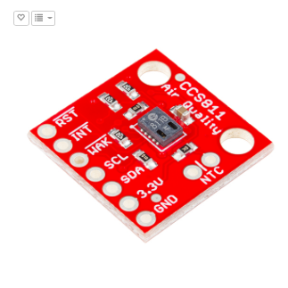
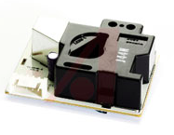
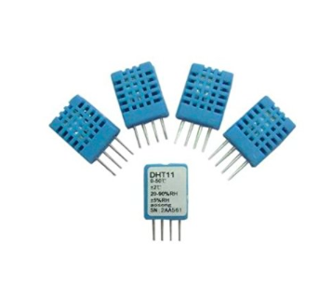
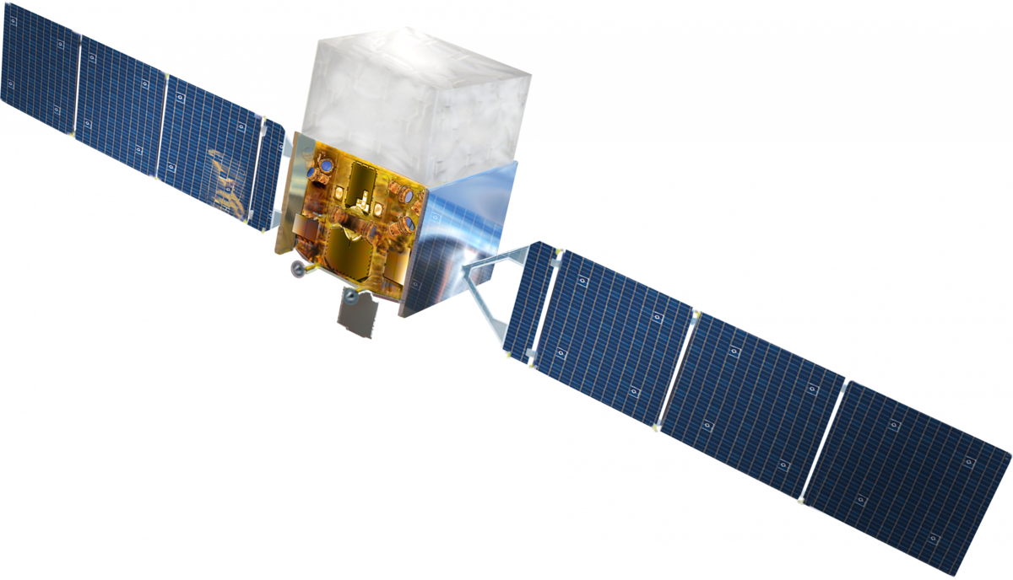


Data Acquisition
Pollution and ambient data collected using low-cost sensors
VOC
CO₂
PM
%
SparkFun Air Quality Sensor
Breakout Model # CCS811
Amphenol Advanced Sensors SM-PWM-01C
Geeetech 4PCS DHT11 Digital Humidity Temperature Sensor
In-Built Geoloc
& Satellite Data
CE 186: Bill of Materials
Motivation
Mapping
Implementation
Review

Slide 4


The Road So Far
VOC, PM, CO2, temperature, and user data is sent to cloud
VOC
PM
User performance requirements
CO₂
Motivation
Mapping
Implementation
Review

Slide 5




Data Path
Ambient pollution data sent to cloud and then to stakeholders
CO₂
VOC
PM
Motivation
Mapping
Implementation
Review

Slide 6
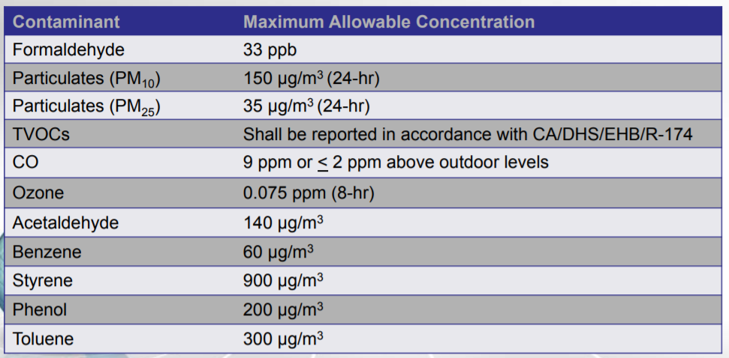
Aggregation and Threshold Checking
Processing of data for display and and decision making
Standard and performance based criteria
Aggregation of data
Statistical summary
Recommendation engine
Cumulative exposure, real time plotting
IAQ heat map
Motivation
Mapping
Implementation
Review

Slide 7
Recommendation Engine
Compare target IAQ change to to potential actions and advise.
Building facts (use input)
Function for expected effect size.
Select optimal strategies.
Potential Strategies
Turn on fans
Modify HVAC schedule
Change finishes
Cross ventilation
Air filtration
Avoid pollutant generating activities
…. or allow users to test how effective their own strategies are
Outdoor air quality (from other sensors)
Recommendation displayed on web app
Motivation
Mapping
Implementation
Review

Slide 8
Component Connectivity
Prototype solution is made up of hard-wired elements
disk memory access
Server / DB
hard drive on PC
Python ListenAndProcess.py
hard drive on PC
JQuery
HTML/ JS
Disk / SD card of SQL database
Python
ListenAndSend.py
hard drive on PC
PM
USB
hardwire
VOC
CO₂
Arduino
SendData.ino
disk on Arduino
hardwire
hardwire
Motivation
Mapping
Implementation
Review

Slide 9
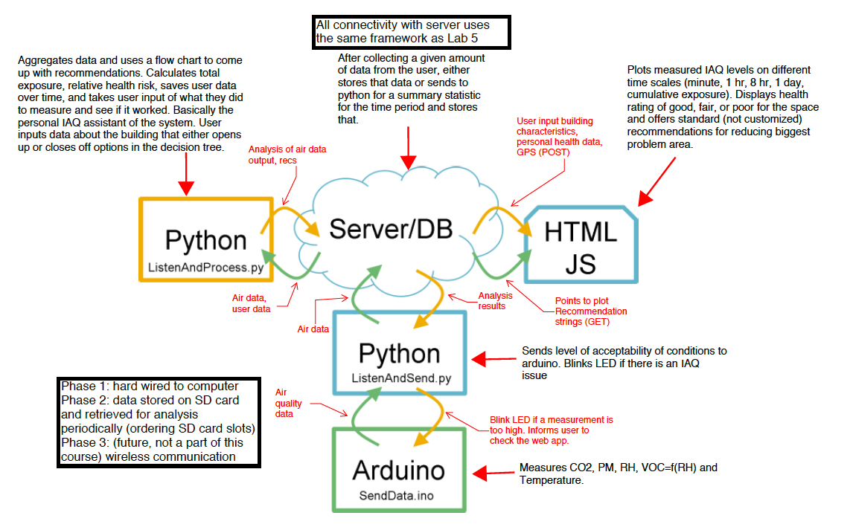
Data Map
Air quality data is sent between components and analyzed
Motivation
Mapping
Implementation
Review

Slide 10
– Hardware and Data:
In this update, your hardware bill of materials must be finalized (Brian).
You should also have all purchase orders submitted, and ideally have the hardware in-hand (??) .
You should also have a list of data types you will collect (e.g. temperature, GPS coordinates, water flow, voltage), and how you will acquire this data (e.g. sensors, Google Maps API) (Garima).
-Background on our problem and why air quality is important (John_

Slide 11
Deliverables assignments
Criteria to research - healthy limits based on health conditions - metrics for assessing indoor air quality - think of recommendations - effect of different actions and actuation on PM, CO2 and Temp Hardware to build - test bed - CO2 sensor, - Wooden box - AutoCAD or pdf to svg, with ports scaled for the air input - Potential weatherstripping for outdoor use - easily bought weatherstripping -

Slide 12
LAB5, Part
2, specialized to your CPS project. Please be prepared to explain
how sensors are connected with Arduino (plugged in - not wireless)
and how Arduino is connected with servers (our computer is hard wired to the arduino)
how servers are connected with data analysis engines / visualizations (server is hosted on personal computer, data analysis lives on hard drive of personal computer)
Schematics and diagrams are effective for portraying this
architecture. If you have updates on your hardware, sensors, and data collection, then please
share it as well.

Slide 13
Category | Item Name | Description | Price Per Item | Quantity | Cost | Supplier
Micro-Controller | Micro-controller (Arduino) | Class - provided | $0 | 1 | $0 | CE186
Sensor | DHT11 Digital Humidity Temperature Sensor | Digital Humidity Sensor (4pcs package) | $2.00 | 4 | $7.99 | Geeetech
 | SparkFun Air Quality Breakout - CCS811 | Senses VOCs, CO2, MOX (Metal Oxide Level) | $19.95 | 1 | $19.95 | SparkFun
 | Dust Sensor |  | $12.34 | 1 | $12.34 | AlliedElectronics
 | PM sensor | GP2Y1010AU0F Onboard for Measuring PM2.5 Air Purifier | $18.99 | 1 | $18.99 | WaveShare
Power Supply | Wall Adapter Power Supply - 5V DC 2A (Barrel Jack) | Power Supply for Arduino Micro-controller | $5.95 | 1 | $5.95 | SparkFun
Physical Sensor Container | Plywood 1/8" x 15" x 30" | Russian Birch Wood | $1.50 | 3 | $4.50 | Jacobs
Microcontroller (Arduino Uno) supplied by CE 186
DHT11 Digital Humidity Temperature Sensor - Digital Humidity Sensor (4pcs package) - $2.00 supplied by Geeetech
SparkFun Air Quality Breakout CCS811 - Senses VOCs, CO2, MOX (Metal Oxide Level) - $19.95 supplied by SparkFun
GP2Y1010AU0F Onboard for Measuring PM2.5 Air Purifier - PM2.5 Sensor - $18.99 supplied by WaveShare
Wall Adapter Power Supply 5V DC 2A (Barrel Jack) - Power Supply for Arduino Micro-controller - $5.95 supplied by SparkFun
Russian Birch Wood Plywood 1/8" x 15" x 30" - $4.50 supplied by Jacobs Hall

